Slide 1
Florida Statewide Uniform Training Curriculum for Poll Workers.
Florida Department of State
Division of Elections
R. Joyce Griffin
Monroe County Supervisor of Elections
August 21, 2016

Slide 2
“ICE” Tabulators “ImageCast Evolution” Tabulator Both tabulators must be used.

Slide 3
Turn Off
All Cell Phones

Slide 4
No More Blue Change Forms We are now using Voter Registration Applications

Slide 5
Poll Workers and their Cell Phones
Poll workers should not use their cell phones while at work in the polling place. If you have an emergency, please make arrangements with the Clerk to step outside. Do not make your cell phone activity a burden on the other workers.

Slide 6
TOPIC 1:
WHAT IT MEANS TO BE
A POLL WORKER

Slide 7
The Goal of This Topic
…to help you become aware of your general responsibilities as poll workers and the importance of your role to the election process.
TOPIC 1: WHAT IT MEANS TO BE A POLL WORKER

Slide 8
As a Poll Worker :
Ensure equal, non-discriminatory access to the election process for all voters;
Ensure fair and uniform treatment of all voters;
Eliminate any practices at the polls that might be perceived as intimidating to any voter;
Protect the rights of others;
Ensure the integrity, both perceived and actual, at the polling place.
TOPIC 1: WHAT IT MEANS TO BE A POLL WORKER

Slide 9
Legal Elections
It is illegal to conduct an election in any way that benefits or favors one or more candidates.
Violating state or federal law
resulting in criminal charges.
TOPIC 1: WHAT IT MEANS TO BE A POLL WORKER

Slide 10
Prohibited Practices
Under Florida law, it is illegal for you to:
Destroy, remove, alter, or mark ballots.
Campaign, distribute campaign literature, or permit campaign literature to be present or allow anyone to electioneer at the polls.
Commit or knowingly permit fraud of any kind.
TOPIC 1: WHAT IT MEANS TO BE A POLL WORKER

Slide 11
Under Florida law, it is illegal for you to:
Threaten or intimidate voters or allow them to be intimidated.
Knowingly permit an unqualified voter to vote, or permit someone to vote more than once.
Intentionally make or attempt to make a false canvass of the ballots, or make a false statement of the result of the canvass.
TOPIC 1: WHAT IT MEANS TO BE A POLL WORKER

Slide 12
Under Florida law, it is illegal for you to:
Communicate with others regarding someone’s vote, or look at a voted ballot.
Enter a voting booth with a voter, unless the voter requests assistance.
Destroy or alter the list of voters, the precinct register, challenges or affidavits.
TOPIC 1: WHAT IT MEANS TO BE A POLL WORKER

Slide 13
Under Florida law it is illegal for you to:
Induce a voter to vote in a certain way, reveal his or her vote, or keep a record of anything occurring in the voting booth.
Knowingly deny a qualified voter the right to cast his or her vote.
Administer the election on different terms for different racial groups, even without the intention to discriminate.
TOPIC 1: WHAT IT MEANS TO BE A POLL WORKER

Slide 14
In addition, you must not:
Discuss candidates or issues during your work time at the polls.
Jeopardize the privacy of voters or their choices on Election Day or early voting days.
TOPIC 1: WHAT IT MEANS TO BE A POLL WORKER

Slide 15
In addition, you must not:
Bring any politically oriented reading material into the polling place.
Request, suggest, or seek to persuade any voter to vote for any particular candidate or issue.
Take pictures or video or allow others to take photos of any kind inside the polling place.
TOPIC 1: WHAT IT MEANS TO BE A POLL WORKER

Slide 16
In addition, you must not:
Answer any questions the voter may have in regards to helping them decide who or what to vote for.
Look at a voter’s voted ballot.
TOPIC 1: WHAT IT MEANS TO BE A POLL WORKER

Slide 17
In addition, you must not:
Make comments or facial or hand expressions concerning voters’ conversations or comments regarding how they will vote, how they voted, or their opinions about the candidates or issues.
React to or make comments about a voter’s request to change political party affiliation.
TOPIC 1: WHAT IT MEANS TO BE A POLL WORKER

Slide 18
Safety First!
Poll workers must:
Be aware that safety is a priority;
Perform your work in a safe manner;
Be concerned with the safety and welfare of others around you; and
Use common sense.
TOPIC ONE: WHAT IT MEANS TO BE A POLL WORKER

Slide 19
Personal Safety Tips
Do not wear distracting jewelry or watches to the polling place.
Leave extra cash and credit cards at home.
Take only what you need to the polling place.
Find a safe place for your purse or other valuable belongings.
TOPIC ONE: WHAT IT MEANS TO BE A POLL WORKER

Slide 20
Personal Safety Tips
As you are leaving at night, have your car keys in your hand and glance over the parking lot before walking to your car.
Leave the polling place as a group.
TOPIC ONE: WHAT IT MEANS TO BE A POLL WORKER

Slide 21
What Not to Bring
Politically oriented items.
Radios, televisions, or laptop computers.
Children or pets.
TOPIC 1: WHAT IT MEANS TO BE A POLL WORKER

Slide 22
What to Bring
Food and drink for the day.
Any medication you may need to take while you are working at the polling place.
A sweater or light jacket as temperatures may vary inside the polling place.
A pillow or cushion for your chair.
TOPIC 1: WHAT IT MEANS TO BE A POLL WORKER

Slide 23
Dress Code
Be well-groomed, modest, and neat.
Be dressed in clean and comfortable clothes.
Avoid written messages on T-shirts that could be offensive.
Wear a nametag.
Do not wear politically oriented campaign buttons, T-shirts, or any other items with political messages.
TOPIC 1: WHAT IT MEANS TO BE A POLL WORKER

Slide 24
The Poll Worker’s Essential Qualities
Be attentive to the voter and his or her need to cast a ballot that will be counted;
Ensure that the election laws of Florida are carried out at your precinct;
Be of service to the voters and your precinct team;
TOPIC 1: WHAT IT MEANS TO BE A POLL WORKER

Slide 25
TOPIC 2:
THE ELECTION TEAM

Slide 26
The Goal of This Topic
… to allow poll workers to understand the election team and their part in the team effort to conduct a fair, just, and accurate election.
TOPIC 2: THE ELECTION TEAM

Slide 27
The Team
Supervisor of Elections
Supervisor of Elections Staff
Roaming Clerk
Clerk
Asst. Clerk
Inspectors/ICE Clerk & Deputy

Slide 28
Election Board
Consists of poll workers who serve as clerks and inspectors in each precinct.
Is charged with setting up the polling place and conducting the voting.
TOPIC 2: THE ELECTION TEAM

Slide 29
Clerk Responsibilities
Required to oversee the activities of the Election Board;
Responsible for the accurate completion of all affidavits and paperwork;
Assist inspectors;
TOPIC 2: THE ELECTION TEAM

Slide 30
Clerk’s General Duties Election Day:
Take the oath.
Administer the oath to all Election Board members before 7:00 a.m.
Check for complete delivery of all voting equipment and supplies.
Check for correct precinct numbers on all voting equipment, signs and ballots.
Have all poll workers sign the payroll sheet.
Assist with pre-election setup of the polling place.
TOPIC 2: THE ELECTION TEAM

Slide 31
Clerk’s General Duties Election Day:
Make sure that precinct registers are staffed at all times.
Make sure that the polling room remains free of campaign literature, sample ballots, etc.
Assign lunch and break times in accordance with election turnout.
TOPIC 2: THE ELECTION TEAM

Slide 32
Clerk’s General Duties Election Day:
Station the poll workers to ensure that voters are being processed correctly and ballots are being issued correctly.
Make sure that all poll closing tasks are completed.
Oversee ballot counting and reconciliation.
TOPIC 2: THE ELECTION TEAM

Slide 33
Assistant Clerk
The Assistant Clerk shall assist the Clerk with their duties.
The Assistant Clerk should learn the clerks job. If the clerk is unable to perform the Clerk’s job, the Assistant will be able to step into the Clerk’s position.

Slide 34
Inspectors / ICE Clerks Deputies
Report to the precinct at the designated time, 6:00 A.M.
Take the oath.
Set up required signs and information inside the polling place.
Assist with pre-election setup of the polling place.
TOPIC 2: THE ELECTION TEAM

Slide 35
Inspectors / ICE Clerks and Deputies
Do not show partiality to any political party or candidate.
Make sure that the voting equipment is attended at all times.
Help close the polls, after everyone in line at 7:00 p.m. has voted.
Assist the Clerk and Asst. Clerk when asked.
TOPIC 2: THE ELECTION TEAM

Slide 36
Poll Deputy
Maintain law and order outside the polling place. Must follow the lawful commands of the clerk.
The Deputy should be aware of the 100 foot “no solicitation” zone.
The zone is measured from the door of the building that holds the polling room, not from the sidewalk.
Where the 100’ area ends and private property begins. In some polling places this will extend the zone off the poll place property.

Slide 37
General Poll Deputy Duties:
Report to assigned polling place 6:00 A.M.
Sign payroll sheet.
Remain outside the voting area and stay alert to all circumstances surrounding the polling location.
Enter the building only with the consent of the Clerk.
TOPIC 2: THE ELECTION TEAM

Slide 38
General Poll Deputy Duties:
Be pleasant and courteous at all times.
Assist voters into the polling room.
Never send a voter away for any reason.
Maintain order and enforce the 100-foot, no solicitation boundary. Check with the Clerk to see if the polling place property owner has declared the private property a no solicitation zone.
TOPIC 2: THE ELECTION TEAM

Slide 39
General Poll Deputy Duties:
Arrange breaks with the Clerk.
Regulate the number of voters admitted to the polling room, if necessary.
Summon assistance from bystanders, if possible, when necessary to maintain peace and order at the polls.
TOPIC 2: THE ELECTION TEAM

Slide 40
General Poll Deputy Duties:
Stand at the end of the voting line at 7:00 p.m. when the clerk declares the polls are closed.
Allow everyone in line at 7:00 p.m. to vote.
Do not allow any one who is not in line at 7:00 p.m., when the polls close, to vote.
Do not handle the ballots, unless assigned to assist the clerk.
TOPIC 2: THE ELECTION TEAM

Slide 41
TOPIC 3:
THE VOTER AND
OTHER PARTICIPANTS

Slide 42
The Goal of This Topic
… to allow poll workers to understand the legal parameters and roles of voters and other participants in the election process.
TOPIC 3: THE VOTER AND OTHER PARTICIPANTS

Slide 43
Voters May Require Assistance
Voters who cannot read or write, or are blind or otherwise disabled, have the right to request assistance with voting.
Any voter has the right to receive a demonstration explaining how to use the voting system.
TOPIC 3: THE VOTER AND OTHER PARTICIPANTS

Slide 44
Voters May Require Assistance Completing Forms
You may assist voters completing forms.
The voter must sign all forms.

Slide 45
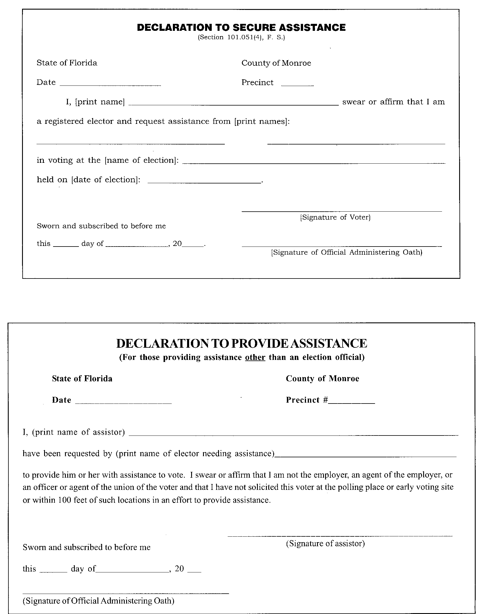
Declaration to Secure Assistance.
To be filed by voter and person assisting voter; if the voter has not registered as “Needing Assistance.”

Slide 46
Who Else Is Allowed in the Polling Room?
Poll workers.
The Supervisor of Elections or representative of the elections office.
Poll watchers approved by the Supervisor of Elections.
Election observers appointed by the state.
Voters.
TOPIC 3: THE VOTER AND OTHER PARTICIPANTS

Slide 47
Who Else Is Allowed in the Polling Room?
Persons caring for or assisting a voter.
Law enforcement or emergency personnel with permission of the Clerk or the majority of the Election Board.
The public, if the polling room is in a commonly used area, to pass through in order to move to another location within the building.
TOPIC 3: THE VOTER AND OTHER PARTICIPANTS

Slide 48
Poll Watchers
Each political committee, political party, and candidate may have one poll watcher in each polling room at any time during elections.
Poll watchers will receive a name tag from the SOE and must wear it at all times while acting as a poll watcher.
TOPIC 3: THE VOTER AND OTHER PARTICIPANTS

Slide 49
Poll Watchers Cont’d
May observe the voter check-in process.
May enter challenges to voters.
May not obstruct the conduct of the election.
May not interact with voters.
Pose any questions or concerns that they may have to the clerk.
TOPIC 3: THE VOTER AND OTHER PARTICIPANTS

Slide 50
With Regard to Poll Watchers,
Poll Workers Must:
Make certain that no voters feel that they are being watched for whom, or what , they vote.
Not allow voters to be delayed by the poll watchers.
Notify the Supervisor of Elections office if a poll watcher abuses a voter’s rights.

Slide 51
Poll Watchers Must:
Give their name to the clerk for verification.
Be allowed within the polling room to observe.
Be allowed to inspect the precinct registers.
Inform the clerk if they wish to challenge a voter’s right to vote.
Wear their name tag.

Slide 52
Poll Watchers May:
Examine the voting machine when it is not in use.
Be given information about who has voted.
Be present at poll closing, ballot accounting and reconciliation.
Inform the clerk if they see or hear anything that does not comply with election laws.

Slide 53
Poll Watchers May Not:
Walk around the voting area.
Participate in any manner in the conduct of the election.
Remove any materials from the precinct register or any materials that are under the direction and control of the Supervisor of Elections.
Electioneer within 100 feet of the polling place.

Slide 54
Poll Watchers May Not:
Volunteer to help electors who need assistance to vote.
Use the precinct phone.
Wear or display any campaign materials.
Obstruct the orderly conduct of any election.
Come closer to the officials’ table or the voting booths than is reasonably necessary.

Slide 55
Who Is Not Allowed in the Polling Room?
Except to vote or observe the opening or closing of the polls.
Press and Candidates
Solicitors
Cannot solicit within 100 feet of the polling place or early voting site.
Cannot conduct polls within 100 feet of the polling place.
Exit Pollsters
TOPIC 3: THE VOTER AND OTHER PARTICIPANTS

Slide 56
TOPIC 4:
OPENING PROCEDURES
FOR THE POLLING PLACE
ON ELECTION DAY

Slide 57
The Goal of This Topic
… to inform poll workers
how to properly open the polls.
TOPIC 4: OPENING PROCEDURES FOR THE POLLING PLACE ON ELECTION DAY

Slide 58
Time to Open the Polls
It is statutorily mandated that polls open at 7:00 a.m.
All poll workers must arrive by 6:00 am to assist in setting up the polling place.
TOPIC 4: OPENING PROCEDURES FOR THE POLLING PLACE ON ELECTION DAY

Slide 59
1. Set Up the Polling Room
Arrange voting equipment, voting booths, tables and chairs.
Set up phone and call Elections office.
Synchronize watches and clocks with tabulators. Check time on cell phones.
TOPIC 4: OPENING PROCEDURES FOR THE POLLING PLACE ON ELECTION DAY

Slide 60
3. Privacy Must Be a Priority in Setting Up the Room
Be sure placement of the voting booths safeguards voter privacy.
Check paths to ensure a smooth flow from the inspector, voting booth, and tabulator.
TOPIC 4: OPENING PROCEDURES FOR THE POLLING PLACE ON ELECTION DAY

Slide 61
4. Accessibility for People with Disabilities
Polling place must be accessible.
Polling place must have at least one voting booth designed to be used by voters who need to sit.
Sufficient lighting must be set up along an accessible path and within the polling place.
TOPIC 4: OPENING PROCEDURES FOR THE POLLING PLACE ON ELECTION DAY

Slide 62
5. Precinct Register
Tables should be arranged to provide poll workers with room to sit and have enough space to check voter eligibility.
Precinct registers should be placed on the tables in alphabetical order
Pens should be placed near each precinct register to allow voters to comfortably sign their name.
TOPIC 4: OPENING PROCEDURES FOR THE POLLING PLACE ON ELECTION DAY

Slide 63
6. Safety Inspection
Do not overload outlets.
Make sure all poll workers are aware of the location of emergency exits and telephones.
Make sure floors are level, firm, stable, and slip-resistant.
TOPIC 4: OPENING PROCEDURES FOR THE POLLING PLACE ON ELECTION DAY

Slide 64
7. Post Legislatively Mandated Information
Two sample ballots
Two Instructions to Voter posters
Voter’s Bill of Rights and Responsibilities poster
Voter fraud notice
Constitutional amendments or issues if needed
TOPIC 4: OPENING PROCEDURES FOR THE POLLING PLACE ON ELECTION DAY

Slide 65
8. Open the Polls
Open the doors at 7:00 a.m.
Make sure all poll workers are in their assigned locations before the doors open
TOPIC 4: OPENING PROCEDURES FOR THE POLLING PLACE ON ELECTION DAY

Slide 66
TOPIC 5:
DETERMINING IF A VOTER
IS ELIGIBLE

Slide 67
The Goal of This Topic
… to allow poll workers to know the proper procedures for determining if a voter is eligible to vote and properly processing the voter so that he or she may vote.
TOPIC 5: DETERMINING IF A VOTER IS ELIGIBLE

Slide 68
The Voter Arrives
1. Greet voters courteously and cheerfully.
Give voters your full attention.
Remember that you are a public servant.
TOPIC 5: DETERMINING IF A VOTER IS ELIGIBLE

Slide 69
The Inspector
Locates the Voter’s Name in the Precinct Register
Ask the voter’s name and request identification.
If the address on their I.D. matches the address on the precinct register, Do not ask the voter to verify their address.
TOPIC 5: DETERMINING IF A VOTER IS ELIGIBLE

Slide 70
If the address does not match, or in the case of a passport where there is no address listed, you may read the address in the register to the voter. Ask the voter if their address has changed. The voter does not have to respond.
Have the voter sign in the space provided in the precinct register.

Slide 71
Voter Presents I.D.
Valid Florida driver’s license
Florida I.D. card issued by the Department of Highway Safety and Motor Vehicles
US Passport
Debit /Credit Card
Military ID
TOPIC 5: DETERMINING IF A VOTER IS ELIGIBLE

Slide 72
Voter I.D
Student I.D.
Retirement center I.D.
Public assistance
Neighborhood association I.D.
TOPIC 5: DETERMINING IF A VOTER IS ELIGIBLE

Slide 73
NEW Acceptable ID
Veteran health identification card issued by the United States Department of Veterans Affairs – New August 2016
License to carry a concealed weapon or firearm issued pursuant to s. 790.06 – New August 2016 (beware this ID may not have a signature.)
Employee identification card issued by any branch, department, agency, or entity of the Federal Government, the state, a county, or a municipality. – New August 2016

Slide 74
As long as the listed identification has a photo and signature of the voter.
Two ID’s may be used to obtain the Photo and signature requirement.

Slide 75
If the Voter’s Name is Not in the Precinct Register.
Recheck for name variations.
Ask the voter if his or her name has changed.
Voter’s former name appears in the precinct register or electronic database: Voter must complete a Change of Name Affirmation/Voter Registration Application.
TOPIC 5: DETERMINING IF A VOTER IS ELIGIBLE

Slide 76
If the Voter’s Address Has Changed
Send the voter to the clerk
If the voter’s address is different from what is in the precinct register:
Voter’s name appears in the precinct register but he or she indicates a different address:
The voter must complete a Voter Registration Application Form.
TOPIC 5: DETERMINING IF A VOTER IS ELIGIBLE

Slide 77
The clerk will confirm that the voter should be allowed to vote by using the EVID or calling the elections office.
The clerk should collect the following information prior to calling; the voter’s name, date of birth, new address.
The elections office will confirm the voter’s eligibility to vote and give you the voter’s registration number. The party will be given for primary elections.

Slide 78
The voter must complete a Voter Registration Application Form. The clerk will bring the voter back to the inspector and have the inspector write the information on the blue sheets in the back of the poll register.

Slide 79
Address Change inside precinct
If the voter has moved within the precinct, complete the Voter Registration application form.
Bring the voter back to the inspector to sign register and receive ballot.

Slide 80
Address Change outside precinct
If the voter has moved outside your precinct, if time permits, complete the Voter Registration Application Form, and direct the voter to the proper precinct.
If it is after 6:00 PM the form can be completed at the proper precinct.

Slide 81
To find the voter’s correct polling place use the EVID or the purple street index.
If you are not sure, call the elections office.

Slide 82
Voters renting mail boxes are allowed by the business to use the business address as a physical address for mail deliveries.
These addresses may Not be used for a voting residential address.
Physical does not equal RESIDENTIAL.
We need the voter’s current
RESIDENTIAL address & mailing address.

Slide 83
NEW! 2014
If the voter has moved from another Fl county, and is changing their address at the polling place , the voter shall then be allowed to vote a provisional ballot .
* Note - if the voter’s new address corresponds to a different precinct , direct the voter to that precinct to vote.

Slide 84
Possible Precinct Register Notations and What to Do
Address Protected
Ask the voter only if his or her address has changed. If not, continue the voting process.
If yes, send the voter to the clerk for processing.
Absentee Ballot Requested
Send the voter to the clerk.
TOPIC 5: DETERMINING IF A VOTER IS ELIGIBLE

Slide 85
Voted Absentee
Send to Clerk. Clerk should call the Election Office.
Address Update Required
Send to Clerk. Update voters address using a Voter Registration Application form.
Required even if no changes are made to address.
If the voter does not want to complete the registration form to change their address, have the voter vote a provisional ballot.
TOPIC 5: DETERMINING IF A VOTER IS ELIGIBLE

Slide 86
Assistance Required
If Voter wishes voter may use the ICE unit for assistance.
If voter has no one to assist, the clerk shall provide two poll workers to provide assistance. When voting without the ICE unit.
Assistance may be given in completing required forms such as, change of address or Provisional Envelopes. The Voter must sign.
TOPIC 5: DETERMINING IF A VOTER IS ELIGIBLE

Slide 87
3. Voter Signs Precinct Register
Direct the voter to sign the precinct register.
Compare the voter’s signature with the signature on the photo ID and the precinct register.
If the signature does not match, have the voter sign the affidavit “When Signature Is Different”.
If the difference is not due to a temporary situation and is a permanent signature change, have the voter also sign a Voter Registration Application Form.
TOPIC 5: DETERMINING IF A VOTER IS ELIGIBLE

Slide 88
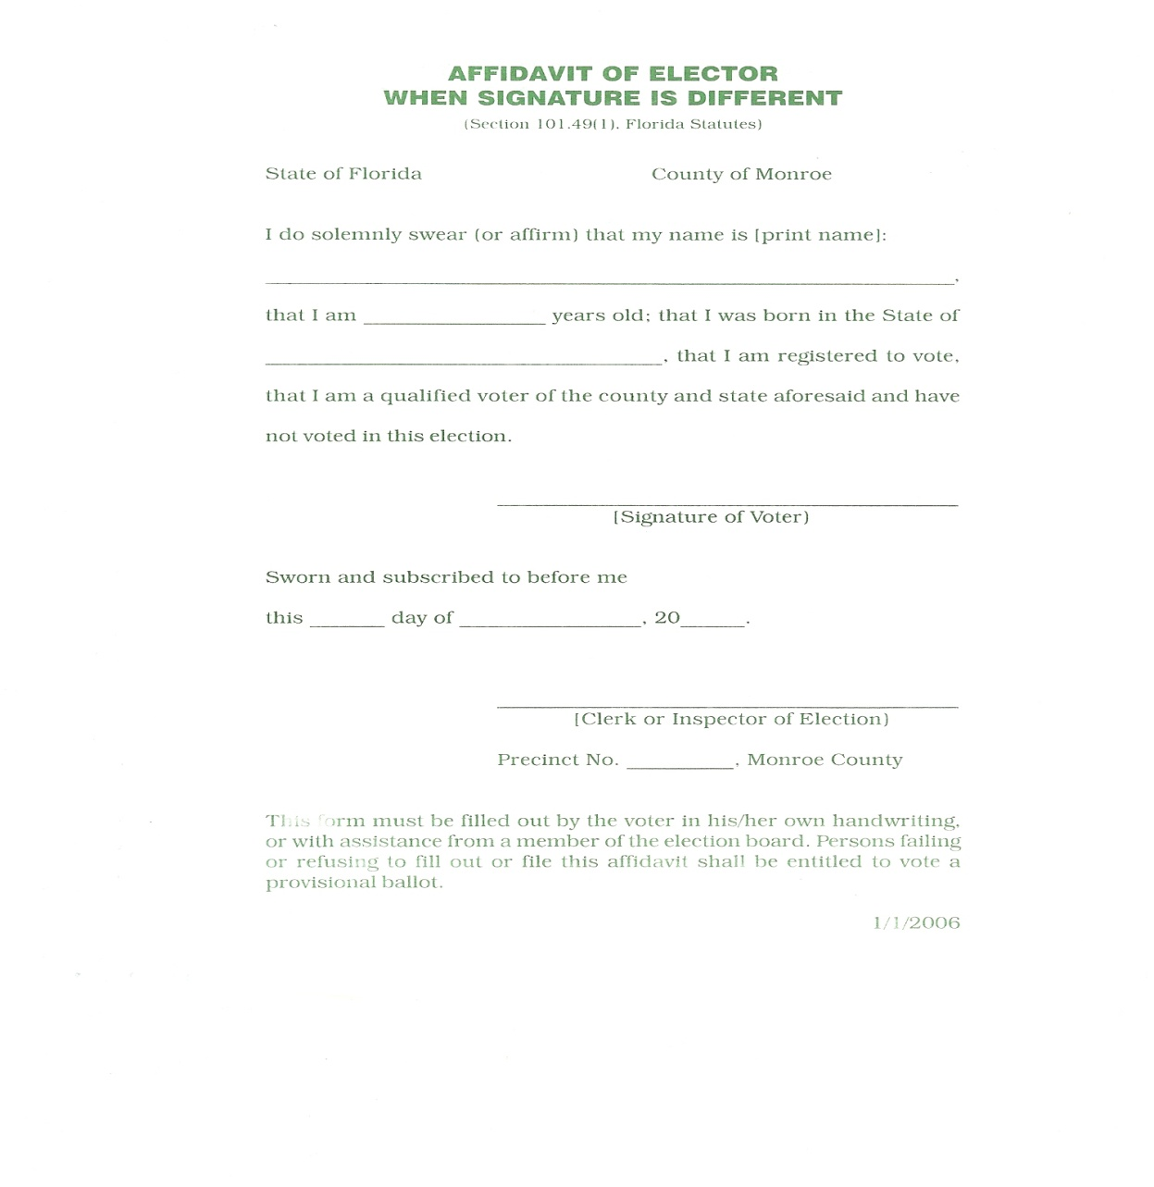
To be signed by voter.

Slide 89
4. Voter Authorized to Vote
If the voter is in the proper precinct,
AND
If the voter has the proper identification,
AND
The inspector is satisfied the person
is entitled to vote,
THEN
The voter may continue the voting process.
TOPIC 5: DETERMINING IF A VOTER IS ELIGIBLE

Slide 90
The inspector should record the ballot stub number and initial the poll register.
The voter should be issued a ballot, security folder, and Audit Ticket.
Audit ticket should be taken from voter by ICE clerk prior to inserting ballot into Tabulator.
TOPIC 5: DETERMINING IF A VOTER IS ELIGIBLE

Slide 91
The voter should be given this explanation of the voting procedures.
Take your ballot to the voting booth
Fill in the oval next to your choice completely. Point to example.
Give the Audit ticket to the ICE Clerk, and place your ballot in the tabulator
After the bell rings, you may leave.

Slide 92
Audit Ticket

Slide 93
5. Voter Votes Ballot
After receiving the voter’s Audit Ticket, the ICE Clerk should inform the voter to insert their ballot into the tabulator and to wait for the bell before leaving.
If they make an error on the ballot, they may choose to vote another ballot, up to 3 attempts to vote a proper ballot. The ballot with the error is spoiled.
Once the voter has cast their ballot, ICE clerk will give the voter their “I Voted” sticker.
TOPIC 5: DETERMINING IF A VOTER IS ELIGIBLE

Slide 94
Never look at a voters ballot for any reason. If the ballot is rejected, look on the tabulator’s monitor for the reason of the rejection. Inform the voter of the reason. The voter may need to see Clerk to spoil the ballot and receive a new ballot.
7. Voter Leaves.
TOPIC 5: DETERMINING IF A VOTER IS ELIGIBLE

Slide 95
TOPIC 6:
SPECIAL SITUATIONS:
WHAT TO DO IF…

Slide 96
The Goal of This Topic
… to allow poll workers to know the proper procedures regarding special situations when the normal processing of a voter presents questions and complexities.
TOPIC 6: SPECIAL SITUATIONS: WHAT TO DO IF…

Slide 97
Absentee Ballot Procedures on Election Day
Precinct Register Indicates
That a Voter Received an Absentee Ballot
If the register indicates that the voter has voted, call the elections office to see if the voter’s absentee ballot was received and opened.
If the status of the voter’s absentee ballot cannot be verified or if the voter challenges the status, allow the voter to vote a provisional ballot.
TOPIC 6: SPECIAL SITUATIONS: WHAT TO DO IF…

Slide 98
Requested Absentee/Surrender of Ballot
If the voter has their absentee ballot, at the polling place: they surrender the absentee ballot to the clerk and are permitted to vote a precinct ballot. The clerk need not call the Elections office to report the surrendered ballot. The clerk will write VOID on the absentee ballot that was surrendered and place it with supplies to be returned election night.
Voted absentee ballots that the voter wants to have counted may not be dropped at any precinct.
TOPIC 6: SPECIAL SITUATIONS: WHAT TO DO IF…

Slide 99
Requested Absentee/Surrender of Ballot
If the voter does not have the ballot, call the elections office.
If the voter’s ballot has not been received by the election office, inform the Deputy SOE that you are going to allow the voter to vote at the polling place.

Slide 100
Precinct Register Indicates That Voter Voted Early
If the voter believes that he or she did not vote at an early voting site, call the Elections office to verify.
If the voter’s status cannot be verified or if the voter challenges the status, allow the voter to vote a provisional ballot.
TOPIC 6: SPECIAL SITUATIONS: WHAT TO DO IF…

Slide 101
Pre-Challenged Voter or
Voter Challenged at the Polls
The person challenging a voter must complete a written oath outlining the reasons why the voter should not be allowed to vote.
The person challenging the voter gives one completed oath to the poll worker and one to the voter.
The Clerk then signs and dates the oath.
TOPIC 6: SPECIAL SITUATIONS: WHAT TO DO IF…

Slide 102
Pre-Challenged Voter/ Voter Challenged at the Polls
The poll worker gives a copy of the completed oath to the person being challenged.
The challenged voter, whether challenged at the polling place or prior to Election Day, shall be permitted to cast a provisional ballot.
TOPIC 6: SPECIAL SITUATIONS: WHAT TO DO IF…

Slide 103
Voter Challenged at the Polls
If the basis of the challenge is that the voter’s legal residence is not in the precinct, the challenged voter shall be given the opportunity to execute a change of address.
If the change places the voter in the same precinct, the voter shall be allowed to vote a regular ballot. If another precinct, the voter shall be directed to the proper precinct. You may send a change form with voter if time allows.

Slide 104
Voter Challenged at the Polls
If the challenged voter does not execute an address change or insists on voting in the current precinct despite a precinct change caused by the address change, the challenged voter must then be allowed to vote a provisional ballot.

Slide 105
Challenge
To be filled out by the person making the challenge. Challenged voter shall vote a Provisional Ballot.

Slide 106
Voter Needs Another Ballot/Spoiled Ballot
A voter is allowed up to three ballots total, including the original ballot.
A voter may NOT receive another ballot after his or her ballot has been counted, even if the voter indicates he or she made a mistake while voting.
TOPIC 6: SPECIAL SITUATIONS: WHAT TO DO IF…

Slide 107
Voter Signs in but Leaves Before Getting a Ballot
Notify the Election Office and Document the incident.
TOPIC 6: SPECIAL SITUATIONS: WHAT TO DO IF…

Slide 108
Ambiguous Mark
An ambiguous mark will not go through the tabulator. If a tabulator indicates that a ballot has an ambiguous mark the ballot must be spoiled and the voter given a new ballot.

Slide 109
Voter Leaves Voting Booth without Casting Ballot
If it is clear that the voter wanted to cast their ballot, the 2 poll workers will push the ballot through the ICE tabulator.
If the voter expressed that they did not want to cast their ballot, spoil the ballot.

Slide 110
Voter Attempts to Take the Ballot from Polling Place
Advise the voter that it is against the law to take a ballot from a polling place.
Explain to the voter that the ballot can be “spoiled” if the voter does not wish to have it counted.
If the voter leaves with the ballot, document the removal, call the Election Office. 104.20 Misd. 1st degree.
TOPIC 6: SPECIAL SITUATIONS: WHAT TO DO IF…

Slide 111
Spoiled Ballot

Slide 112
What to Do If the Voter Does Not Have the Proper I.D.
Notify the clerk.
Allow the voter to vote a provisional ballot.
If you allow any voter to vote without providing proper Identification, you are in violation of Florida Law.
TOPIC 6: SPECIAL SITUATIONS: WHAT TO DO IF…

Slide 113
Provisional Ballots
Who Gets a Provisional Ballot?
A voter who does not have acceptable I.D.;
A voter whose name is in the precinct register, but:
There is an indication that the voter was sent an absentee ballot, and you are unable to determine the status of the absentee ballot or the voter disputes the status;
TOPIC 6: SPECIAL SITUATIONS: WHAT TO DO IF…

Slide 114
Who Gets a Provisional Ballot?
An indication that the voter voted early, and you are unable to determine the voter’s status or the voter disputes the status;
The voter’s driver’s license, Florida identification card, or the last 4 digits of the social security number have not been verified by the Department of State.
TOPIC 6: SPECIAL SITUATIONS: WHAT TO DO IF…

Slide 115
Who Gets a Provisional Ballot?
A voter whose name is not in the precinct register, and:
You are unable to verify whether the person is an eligible voter, or the voter disputes the determination;
You verify that the voter is not registered to vote and the voter disputes your determination.
TOPIC 6: SPECIAL SITUATIONS: WHAT TO DO IF…

Slide 116
A person whose signature differs from that in the poll register, and the person refuses to complete the affidavit.
A voter whose identity is in question based on the photo identification provided.
A challenged voter.
A voter who has moved from another county and has not updated their address with the Elections Office
TOPIC 6: SPECIAL SITUATIONS: WHAT TO DO IF…

Slide 117
Mini Balance
Throughout the day Clerks should be performing Mini Balances.
It is easier to find a mistake when it just happens.
This will also make balancing at the end of the night easier.

Slide 118
Topic 7
Primary Elections.

Slide 119
Primary Elections
Remember:
Generally, in a primary election, a voter may only vote for candidates of the party in which he or she is registered.
Exception, County And Circuit Court Judges and School Board Members, (Non-partisan)
No changes in party affiliation may be made at the polls.
Make sure the voter is given the proper ballot based on his or her party affiliation.
TOPIC 7: GENERAL AND PRIMARY ELECTIONS

Slide 120
Universal Primaries
All candidates for an office have the same party affiliation and the winner will have no opposition in the general election.
All qualified voters, regardless of party affiliation, may vote in the primary elections for that office.
TOPIC 7: GENERAL AND PRIMARY ELECTIONS

Slide 121
Closed Primaries
Voters who are registered as Republicans receive a Republican ballot.
Voters who are registered as Democrats receive a Democratic ballot.
Voters who are registered with no party affiliation or with a minor political party, (and no primary candidates), can only vote on nonpartisan candidates and issues. (School Board, Judicial, Question, and City Candidates)
TOPIC 7: GENERAL AND PRIMARY ELECTIONS

Slide 122
Ballot Styles for a Primary Election
Republican
Democrat
Minor Political Party (2016 Libertarian)
Non-partisan
Ballots by precinct. Make sure your precinct ballots are designated for your precinct.
TOPIC 7: GENERAL AND PRIMARY ELECTIONS

Slide 123
General Election
Elections held on the first Tuesday after the first Monday in November in even-numbered years.
TOPIC 7: GENERAL AND PRIMARY ELECTIONS

Slide 124
TOPIC 8:
CLOSING THE POLLS

Slide 125
The Goal of This Topic
… to allow poll workers to know how to properly close the polls.
TOPIC 8: CLOSING THE POLLS

Slide 126
Poll Closing Time
The polls are mandated to close at 7:00 p.m.
The clerk or other designated elections official shall announce that the polls are closed.
The poll deputy stands at the end of the line, or if all voters are inside in front of the door, to establish a cut-off point.
TOPIC 8: CLOSING THE POLLS

Slide 127
Closing the Polls
All eligible voters who are standing in line at the polling place at 7:00 p.m. are allowed to vote.
Once all voters have voted, the Election Board must secure the voting device so that no more ballots may be cast.
TOPIC 8: CLOSING THE POLLS

Slide 128
Closing the Polls Tasks
Follow the clerk’s instructions, but as a general guide:
Take down the signs, and other materials.
Neatly pack the supply box.
Rearrange tables and chairs as you found them.
TOPIC 8: CLOSING THE POLLS

Slide 129
Follow the clerk’s instructions, but as a general guide:
Leave the polling room and outside area neat, clean and in order.
Follow specific instructions for lights, air conditioning/heating, and door keys.
Lock the doors when leaving.
Do not leave anyone alone at the polling place.
TOPIC 8: CLOSING THE POLLS

Slide 130
Before ballot accounting begins:
The polls must be announced as closed.
All voters in line must have voted.
The voting equipment must be locked against further voting.

Slide 131
Closing the Polls Procedures
Ballot Accounting
After the polls close, the inspectors/election officials shall allow persons near to them to see ballots are being reconciled correctly.
Do not lock polling place doors. Ballot Accounting may be viewed by the public.
Violation= misdemeanor of first degree.
TOPIC 8: CLOSING THE POLLS

Slide 132
Closing Polls/Ballot Accounting
After the polls have closed, the election board will verify the:
number of voted ballots,
unused ballots,
provisional ballots,
and spoiled ballots
the number of those ballots must equal the number of ballots issued by the Supervisor of Elections.

Slide 133
Closing the Polls/Ballot Accounting
If there is a difference, the clerk shall report such difference to the election office, with the reason, if known, at the time they turn in the polling place supplies.

Slide 134
Closing the Polls/Write-In Votes November General Election
Ballots that have write in votes will automatically be sorted to the Write-In compartment of the ballot box.

Slide 135
Closing the polls/Write-In Votes November General Elections
At the close of polls, remove the ballots from the write-in compartment, and place them in the envelope provided for write in ballots.
Complete “Write-In-Tally” Form.

Slide 136
Closing the Polls/ You Must Not:
You Must Not:
Allow anyone to pressure you for results.
Allow anyone to interfere with the closing of the polls in any manner.
Allow anyone to interfere with the counting of the ballots.
Allow anyone who is not part of the Election Board to touch any ballot or voting device.
TOPIC 8: CLOSING THE POLLS

Slide 137
Damaged Supplies
During the day please toss out pens that don’t work, light bulbs that have burned out, and any other used up, burned out, broken down equipment.
Tag booths that are not usable.

Slide 138
Delivery to Elections Office
Chain of Custody Issues
Two or more poll workers will travel directly to the Elections Office.
Turn in the materials
TOPIC 8: CLOSING THE POLLS

Slide 139
TOPIC 9:
CONFLICT RESOLUTION

Slide 140
The Goal of This Topic
… to allow poll workers to be prepared to resolve conflicts that may arise on Election Day or early voting days.
TOPIC 9: CONFLICT RESOLUTION

Slide 141
The Principles of Conflict Management
Consciously Choose Positive Thoughts.
2. Say the Right Words.
TOPIC 9: CONFLICT RESOLUTION

Slide 142
Use positive phrases such as:
I understand.
So what you’re saying is…
Let’s fix this for you.
Thank you.
TOPIC 9: CONFLICT RESOLUTION

Slide 143
Be Aware of Nonverbal Communication.
Do not roll your eyes
Suck your teeth
Scowl or Grimace
TOPIC 9: CONFLICT RESOLUTION

Slide 144
When the Unexpected Happens
Guidelines on How Poll Workers Can Deal with Frustrated or Irate Voters
Stay calm.
Establish eye contact.
Keep your voice down.
Keep your body language non-threatening.
TOPIC 9: CONFLICT RESOLUTION

Slide 145
Show concern using your facial expressions, posture, and tone of voice.
Listen to and acknowledge what the voter is telling you.
Allow at least 2 to 3 feet between you and the voter.
TOPIC 9: CONFLICT RESOLUTION

Slide 146
If the voter is disturbing others, ask him or her to step to another area.
Let the voter know that you want to help them.
Use the person’s name.
Ask questions.
Be polite.
TOPIC 9: CONFLICT RESOLUTION

Slide 147
Deal with the voter’s feelings.
If necessary, ask the clerk or poll deputy to assist you.
Deal directly with the voter’s issue.
Share information with the Supervisor of Elections office.
TOPIC 9: CONFLICT RESOLUTION

Slide 148
If you cannot do exactly what the voter wants, offer a choice or explain what you are able to do.
Explain what you are going to do and how long it will take.
Reassure the voter that you will work with him or her to solve the problem.
TOPIC 9: CONFLICT RESOLUTION

Slide 149
TOPIC 11:
EMERGENCY SITUATIONS

Slide 150
Things to Think About When There Is an Emergency
Call 911.
Call the Supervisor of Elections office.
Determine whether it is necessary to vacate the building.
TOPIC 11: EMERGENCY SITUATIONS

Slide 151
Aid the Supervisor of Elections in determining if it is possible to move the machines, signage, supplies, etc., to permit voting to continue.
If evacuation is necessary, Election Team must make sure everyone leaves safely.
TOPIC 11: EMERGENCY SITUATIONS

Slide 152
If evacuation is necessary and there is no imminent danger, the clerk if possible:
Record the counters on each machine.
Secure materials.
Close the voting equipment and secure it with plastic seals.
TOPIC 11: EMERGENCY SITUATIONS

Slide 153
Loss of Electricity
Ask everyone to remain calm and in place
Call the Supervisor of Elections office
If there is sufficient light, escort voters in and out to continue voting. Tabulating equipment is battery operated.
TOPIC 11: EMERGENCY SITUATIONS

Slide 154
Staff or a voter is injured.
Call 911 if necessary
Call the Supervisor of Elections office
Complete “Report of Incident Form” in Clerks white three ring forms book.
TOPIC 11: EMERGENCY SITUATIONS

Slide 155
Reminders
Did you sign today’s payroll?
Do not be late to polling place. You must be inside at 6:00 am.
Did you bring your Vote by Mail ballot don’t forget to turn it in.
Any Questions?

Slide 156
Movie Time

Slide 157
TOPIC 10:
VOTERS WITH SPECIAL NEEDS

Slide 158
The Goal of This Topic
Sensitivity Training
… to allow poll workers to understand sensitive and effective ways to serve voters with special needs.
TOPIC 10: VOTERS WITH SPECIAL NEEDS

Slide 159
Sensitivity Training
General Information
Accessibililty standards are required at each polling place:
One or more designated accessible parking spaces for disabled persons (for polling places that provide parking spaces for voters);
Signage identifying an accessible path of travel to the polling place;
Bring voters with a disability to the front of the voter check in line.
TOPIC 10: VOTERS WITH SPECIAL NEEDS

Slide 160
An unobstructed path of travel to the polling place;
Level, firm, stable, and slip resistant surfaces;
An unobstructed area for voting;
Sufficient lighting along the accessible path of travel and within the polling place.
TOPIC 10: VOTERS WITH SPECIAL NEEDS

Slide 161
Everything Possible Must Be Done to Accommodate All Voters
Any voter who requests assistance is entitled to receive it.
You should never ask a voter WHY they need help. It is Federal Law.
Part of your responsibility is to ensure that voters know they are allowed to receive assistance.
TOPIC 10: VOTERS WITH SPECIAL NEEDS

Slide 162
The Procedure for Voters Who Need Assistance
Determine if the Declaration to Secure Assistance is on file. (noted in poll register)
Have the voter complete the form prior to voting if necessary.
The voter may have a person of his or her own choosing provide assistance.
TOPIC 10: VOTERS WITH SPECIAL NEEDS

Slide 163
Sensitivity and Etiquette for Voters with Special Needs
Tips on Interacting
with People with Disabilities
Focus on the voter, not the voter’s disability.
Before you act to offer assistance, ask the person how best to help them.
Be considerate of the extra time it might take for a person with a disability to vote.
TOPIC 10: VOTERS WITH SPECIAL NEEDS

Slide 164
Give attention to a person who has difficulty speaking.
Speak calmly, slowly and directly to the voter.
Include people with disabilities in any conversation or activity you may be engaged in within their vicinity.
TOPIC 10: VOTERS WITH SPECIAL NEEDS

Slide 165
How Best to Communicate
Focus on the individual in your language:
Say “person with a disability” rather than “disabled person”
Say “wheelchair user,” not “wheelchair bound”
Say “person who is blind” rather than “blind person”
TOPIC 10: VOTERS WITH SPECIAL NEEDS

Slide 166
Realize that many people with disabilities may not like jargon such as “differently abled.”
Do not use “they” or “them” to refer to people with special needs.
TOPIC 10: VOTERS WITH SPECIAL NEEDS

Slide 167
How to Help
Ask first if the person with a disability wants help, then ask how you can best help.
Respect the personal space of a person with a disability.
Gently touch them on the shoulder or offer your arm
Do not touch a person’s wheelchair without permission
TOPIC 10: VOTERS WITH SPECIAL NEEDS

Slide 168
Voters Who Are Mobility Impaired
Be aware that people in wheelchairs have different levels of ability.
Do not lean across a wheelchair.
Never set anything personal, like a drink, on the tray table that may be attached to some wheelchairs.
Do not touch or pull a person’s wheelchair, cane, or other device without their permission.
TOPIC 10: VOTERS WITH SPECIAL NEEDS

Slide 169
Make sure there are clear paths in the polling room for wheelchairs.
Stand at a distance or sit so a person in a wheelchair does not have to strain to make eye contact.
Make sure ramps provide the closest accessibility to the polling place.
TOPIC 10: VOTERS WITH SPECIAL NEEDS

Slide 170
Make sure ramps, doorways and hallways are not obstructed.
Be aware of the reaching limits of people in wheelchairs.
Step around a high counter or table to conduct your business with a person in a wheelchair.
TOPIC 10: VOTERS WITH SPECIAL NEEDS

Slide 171
Voters Who Are Blind or Visually Impaired
Identify yourself and others who may be with you.
Acknowledge if you are entering or leaving a room.
Be prepared to offer assistance in orienting the individual to the room and objects within it.
Be prepared to offer the voter assistance in reading.
TOPIC 10: VOTERS WITH SPECIAL NEEDS

Slide 172
Let the individual take your arm if you are to lead.
Provide a guiding device such as a ruler or card to help with signing forms.
Be specific and non-visual with directions.
Offer magnifying sheets for visually impaired voters.
TOPIC 10: VOTERS WITH SPECIAL NEEDS

Slide 173
Service Animals
Do not automatically assume that a voter with a service animal is blind.
Do not pet the animal.
Excuse yourself and move away from the service animal if it makes you uncomfortable.
Should someone complain, explain that federal and state laws protect the rights of individuals with disabilities to be accompanied by service animals.
TOPIC 10: VOTERS WITH SPECIAL NEEDS

Slide 174
Voters Who Are Deaf or Hearing Impaired
Speak clearly.
Keep your face, especially your mouth, unobstructed.
If you speak through an interpreter, face the voter who is deaf when you speak.
Listen attentively.
TOPIC 10: VOTERS WITH SPECIAL NEEDS

Slide 175
Do not finish sentences for the person.
If you do not understand the person, do not pretend that you do.
You may find it helpful to communicate in gestures or writing.
To get the attention of someone who is deaf, gently tap his or her shoulder.
TOPIC 10: VOTERS WITH SPECIAL NEEDS

Slide 176
Voters Who Are Mentally Impaired
Be patient.
Speak slowly.
Do not “talk down.”
TOPIC 10: VOTERS WITH SPECIAL NEEDS

Slide 177
Voters Who Speak a Foreign Language
General Strategies for Accommodating Foreign Language Voters…
Talk to the individual, not the interpreter.
Avoid long, complex sentences.
Pause more frequently than normal.
TOPIC 10: VOTERS WITH SPECIAL NEEDS

Slide 178
Watch to make sure the interpreter is keeping up with you.
Only interrupt the interpreter when absolutely necessary.
Avoid excessive gestures and body language.
TOPIC 10: VOTERS WITH SPECIAL NEEDS

Slide 179
TOPIC 12:
Early Voting

Slide 180
The Goal of This Topic
… to allow poll workers to know the specific differences of how to properly handle the work and procedures of early voting days.
TOPIC 12: EARLY VOTING

Slide 181
General Guidelines for Early Voting Procedures
Open the polls
Prepare the voting equipment
Greet voters
Have voters complete the Early Voting Certificate
Request I.D. from voters
TOPIC 12: EARLY VOTING

Slide 182
Note ICE count numbers at the beginning and ending of shifts
Reconcile the number of Early Voting Certificates with the number of votes at each shift change
Report discrepancies to the Supervisor of Elections office
Record the counts on early voting logs each day
TOPIC 12: EARLY VOTING

Slide 183
End of Slides

